Slide 1



“Design & Implementation Of Android Based Fruits Ordering Application : FruitBox”
Guided by-
Submitted By- Group 15
Mr. Surendra Gupta
Associate Professor
Department of Computer Engg.
Ashi Bagedi 0801CS201022
Gurdeep Singh 0801CS201036
Simran Rathore 0801CS201091
Umang Tiwari 0801CS201098
Vikas Dahiya 0801CS201101
Miss Priyanka Kokate
Assistant Professor
Department of Computer Engg.
Department of Computer Engineering
Shri Govindram Seksaria Institute of Technology and Science, Indore(M.P.)
2023-24

Slide 2



Background Study
Source of Origin:
Lack of daily access to fruits and distance from the vendors.
Convenience:
Lack of time for daily shopping and markets are far for daily shopping.
Consumer
Preferences:
Subscriptions for delivery periodically
Prices:
Different prices of fruits on different locations.
Quality:
Market
landscape:
The fruit-selling industry has significant potential for growth in the online channel.

Slide 3
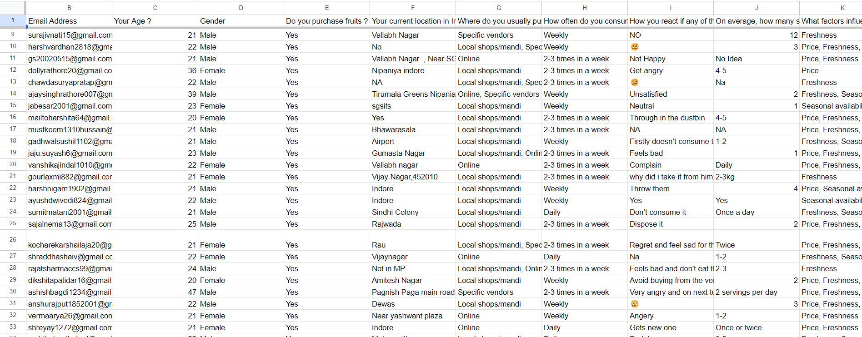
User Survey

Slide 4
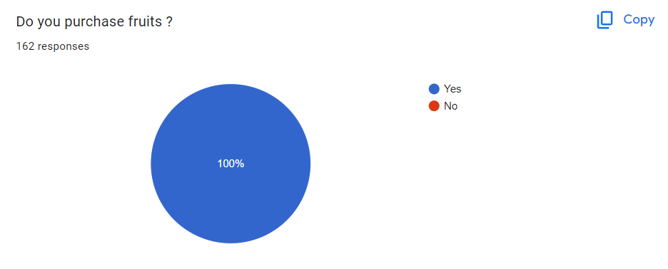
Survey Outcomes

Slide 5
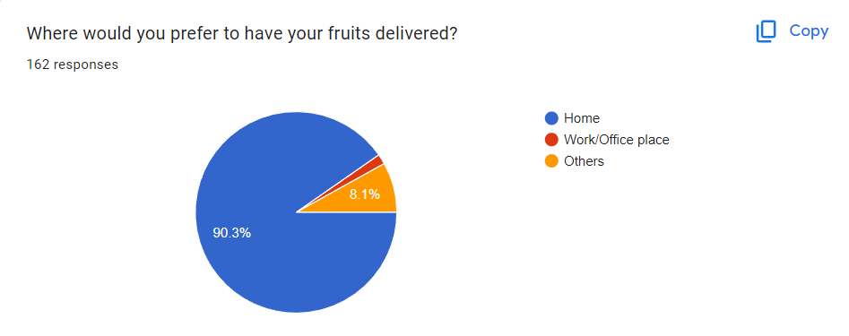
Survey Outcomes

Slide 6
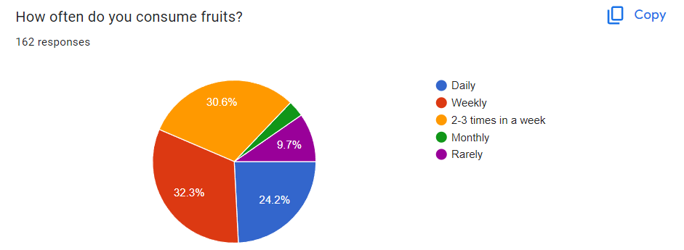
Survey Outcomes

Slide 7
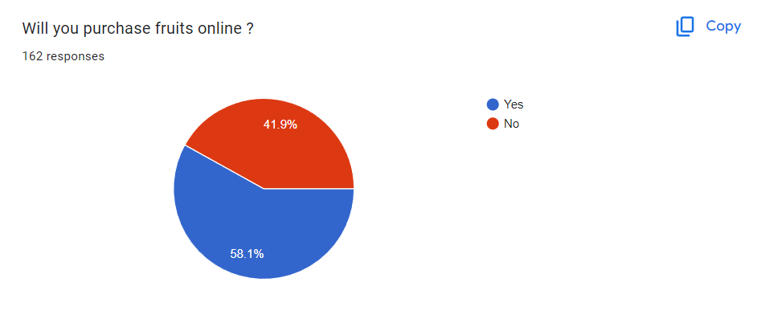
Survey Outcomes

Slide 8
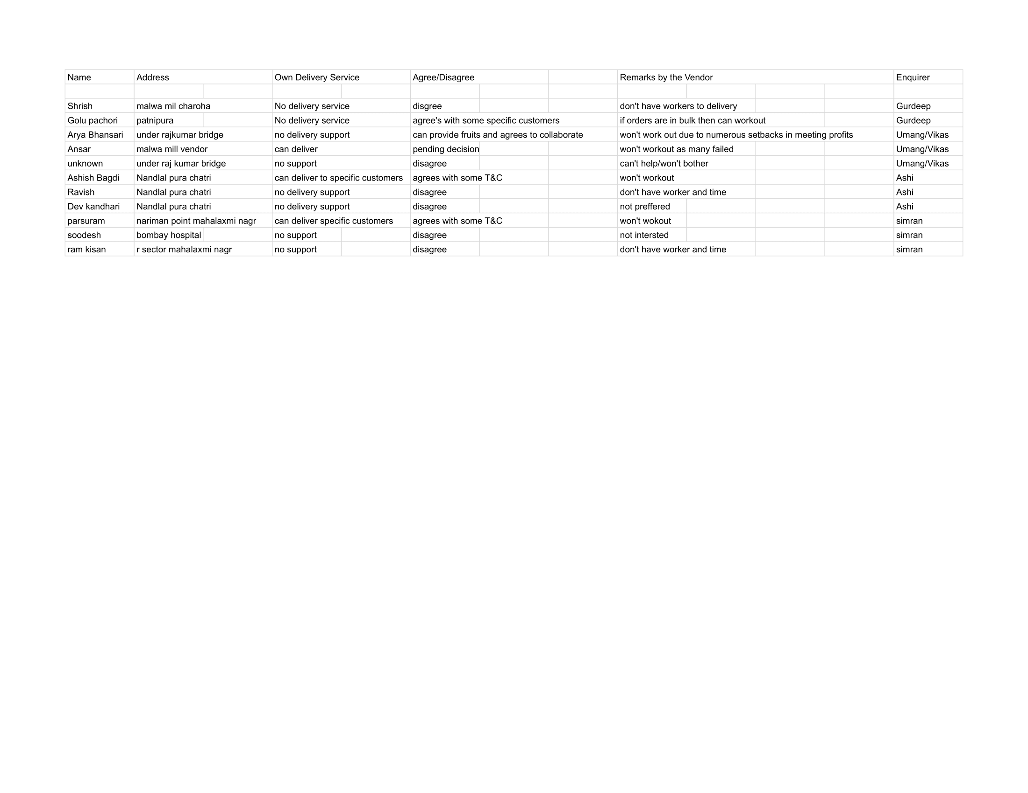
Feedbacks From Vendors In Indore

Slide 9
GAPS IDENTIFIED
Major Project Phase - I
Fewer choices of fruits(Location dependent).
Limited availability of exotic fruits.
Inconvenience for the people who don't have access to transportation.
Unavailability of any subscription based model.

Slide 10
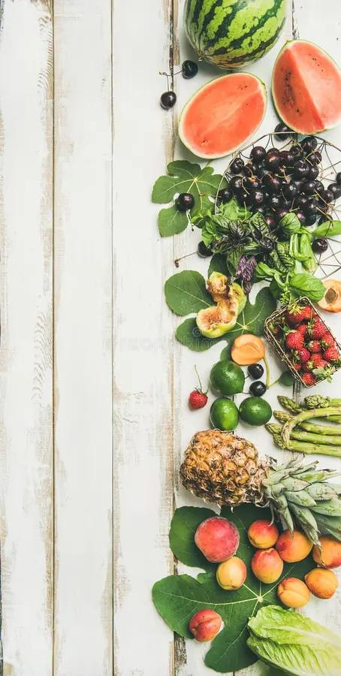

Problem Statement
Major Project Phase - I
It has been observed that customers who are unable to purchase fresh fruits from the market are experiencing challenges like not having enough time to go to market and purchase fruits, unavailability of favorite or exotic fruits, and daily trips to market are inconvenient and time-consuming. Carrying fruits back from the market daily can be burdensome, especially for those who rely on public transportation or have no transportation. Lack of customization in the market based on their. preferences, dietary requirements etc.

Slide 11


Objective
Major Project Phase - I
Our mission is to transform the accessibility of fresh fruits by offering a convenient and sustainable online platform for their delivery. Our goal is to establish ourselves as the primary choice for individuals in search of fresh fruit delivery right to their homes.

Slide 12



Problem in Existing Solution
Major Project Phase - I
Ondoor: Indian online grocery store and delivery platform, which offers a wide range of grocery products. Common issues faced by their customers include incorrect or missing items, poor fruits quality, billing/payment problems .
2. Big Basket: Big basket is an Indian e-commerce platform selling groceries and household essentials online. But customers reported late delivery, poor quality of fruits.
Note: Does not offer any subscription based model for fruit delivery.

Slide 13
Proposed Solution
Collaboration with vendors
Cost Efficiency: By working with vendors, businesses can often benefit from cost-effective sourcing, reducing overall expenses
Quality Control: vendor ensure that the fruits are of high quality and freshness
Reliable Supply Chain: Collaborating with vendors can create a reliable supply chain,

Slide 14
StakeHolders
Customer
Vendor
Delivery Person

Slide 15
Functional Requirements Of Customers
User Registration with phone number
Search fruits
Add to cart
View/Update cart
Place Order
Fruit Category
Logout

Slide 16
Functional Requirements Of Admin Panel
Register/Login
Generate Reports
Edit Data in Database
Manage Applications content

Slide 17
Functional Requirements Of Vendor
Vendor Registration with phone number
Add Fruits
Remove Fruits
Create Profile
Manage Stocks
Accept Orders
Process Orders
Logout

Slide 18
Non Functional Requirements
Major Project Phase - I
Reliability
Security
Scalability
Usability and User Experience
Compatibility
Maintainability

Slide 19

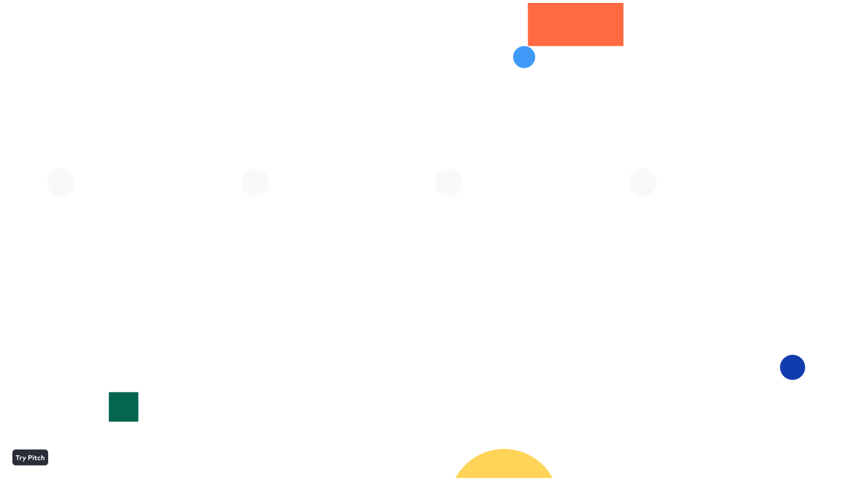
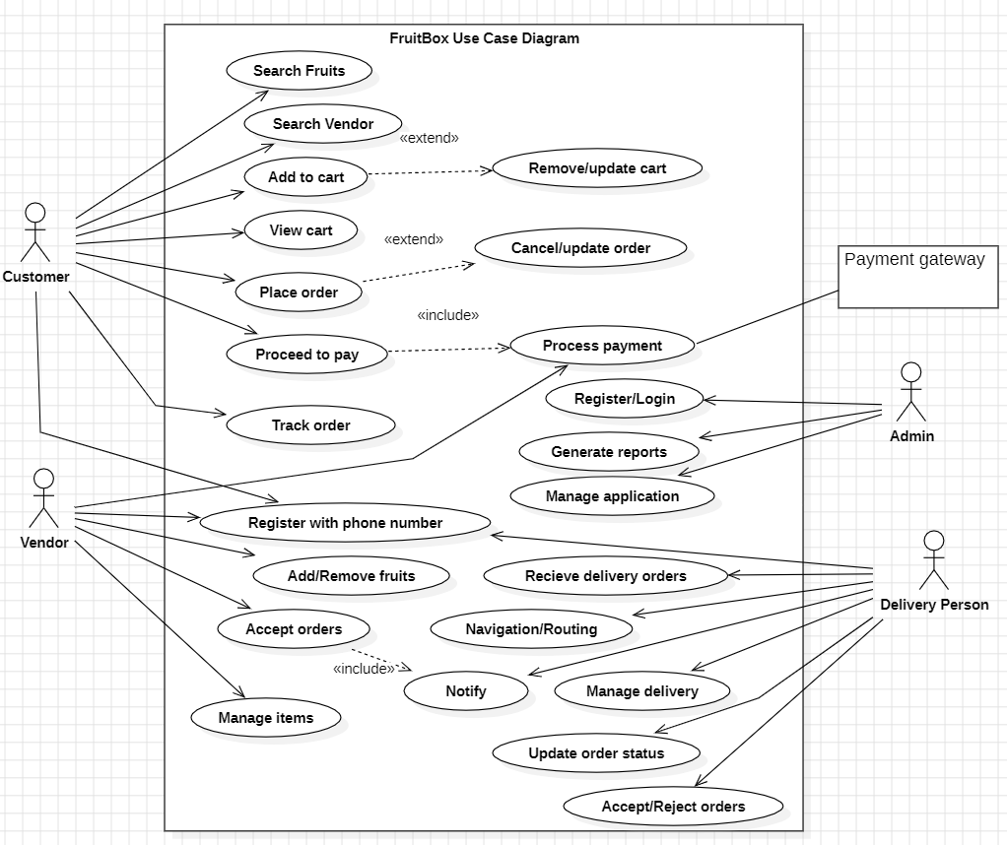
Use Case Diagram

Slide 20
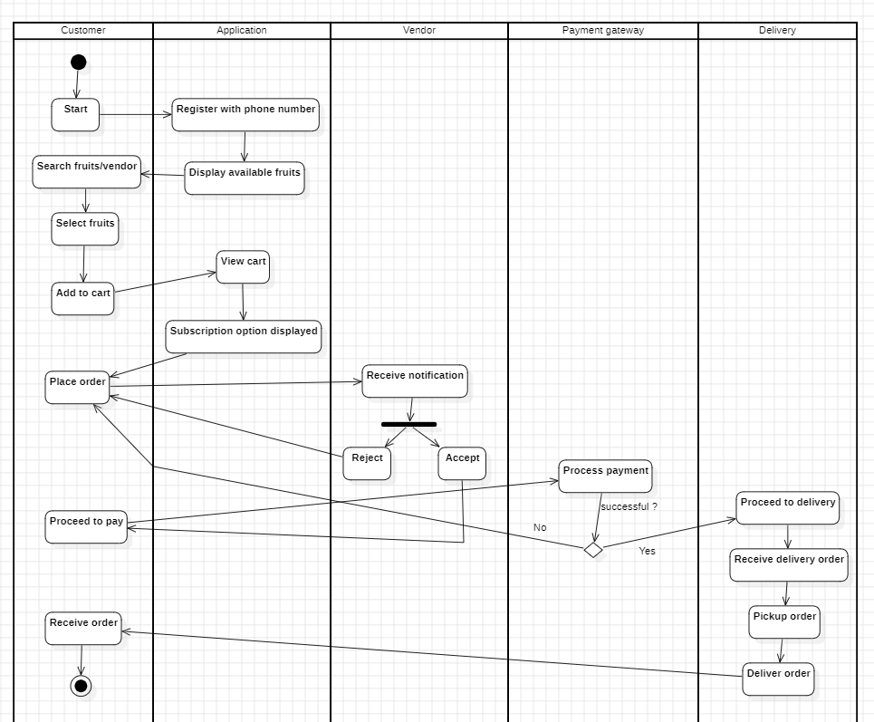
Activity diagram

Slide 21






Technology Used
Frontend
Backend
Database

Slide 22
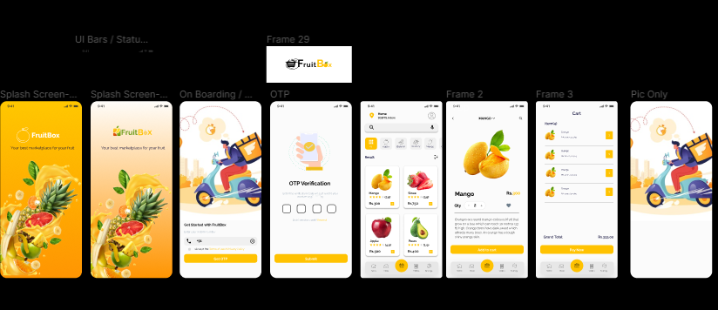
UI Design(Wireframe)
Figma

Slide 23
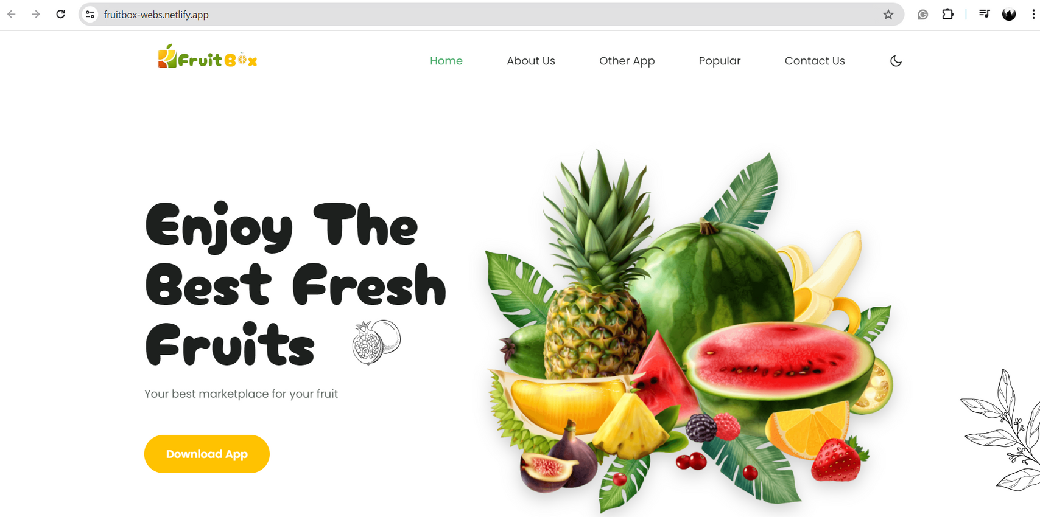
Implementation
Fruitbox Site

Slide 24
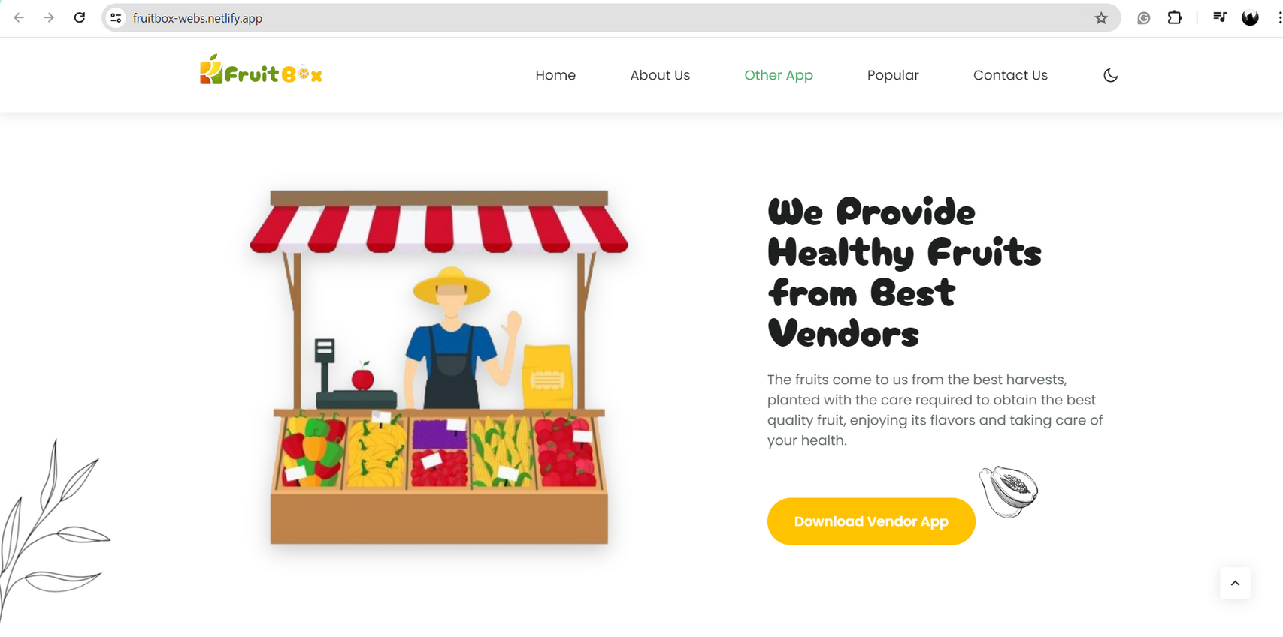
Implementation
Fruitbox Site

Slide 25
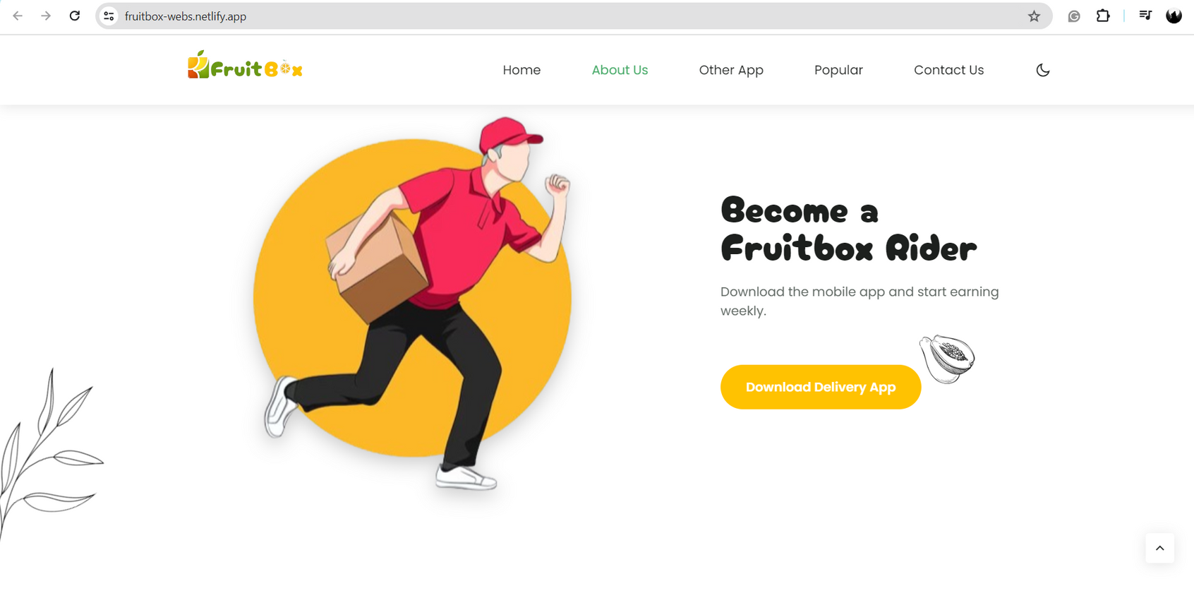
Implementation
Fruitbox Site

Slide 26
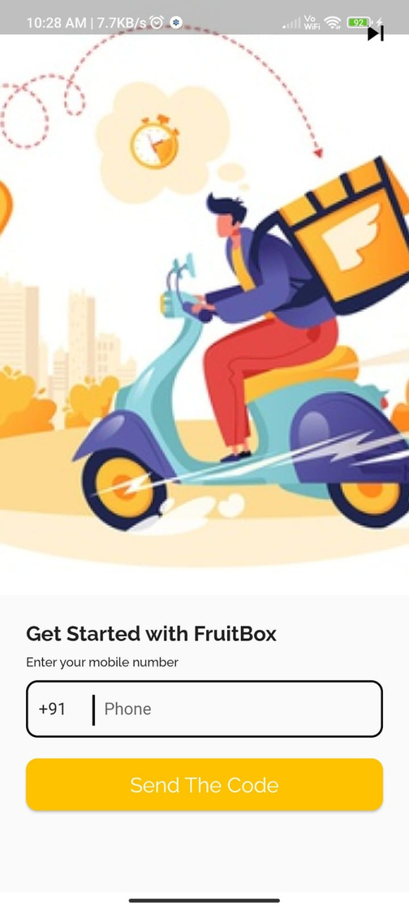
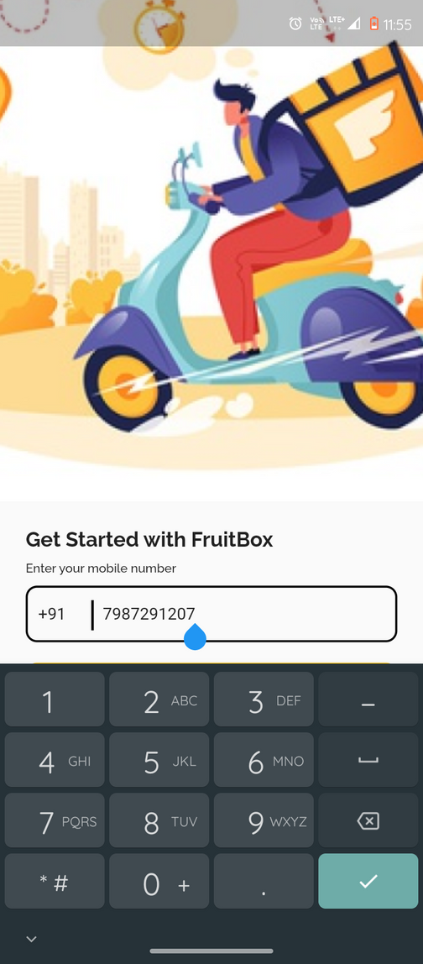
Implementation
Customer App
Login Screen

Slide 27
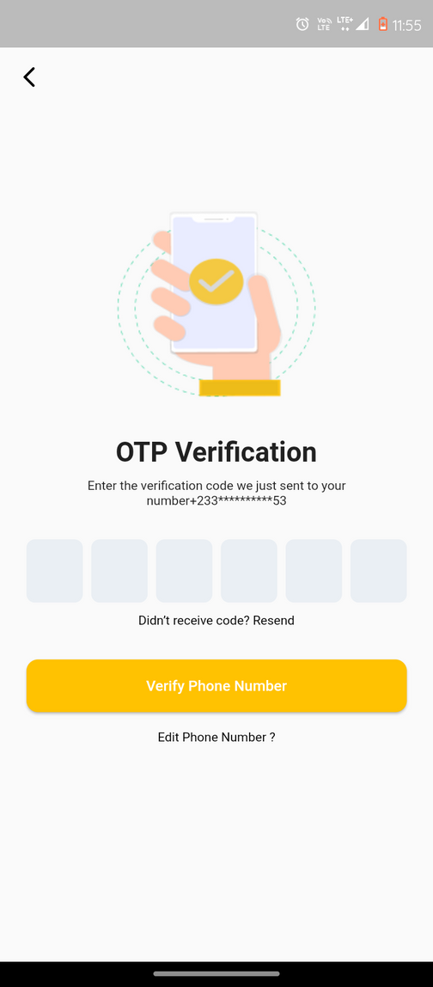
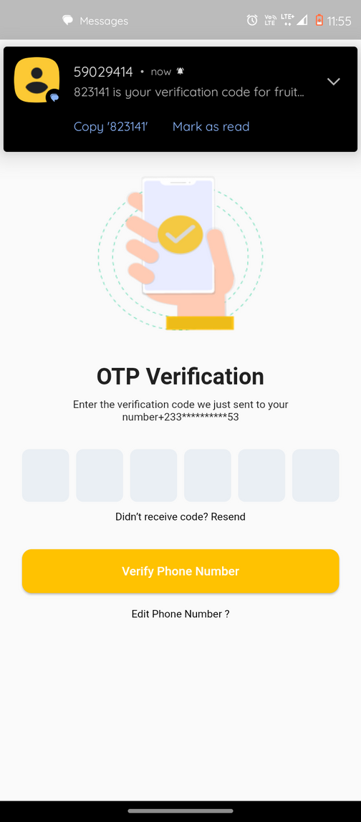
Implementation
Customer App
OTP Screen

Slide 28
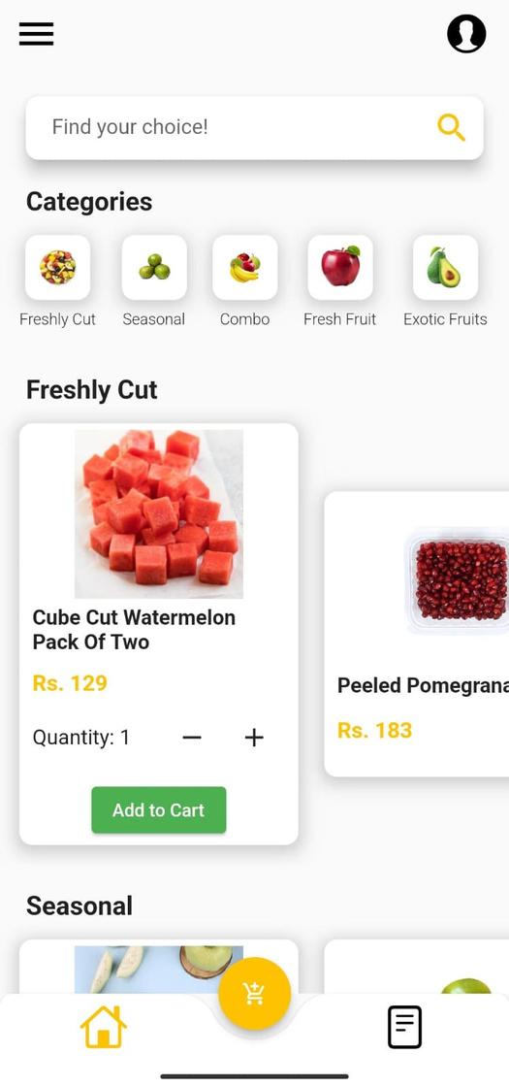
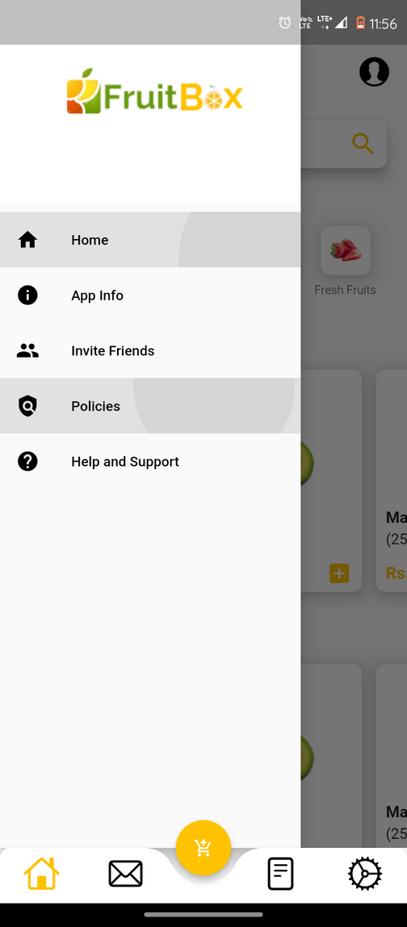
Implementation
Customer App
Home Screen
Side Drawer

Slide 29
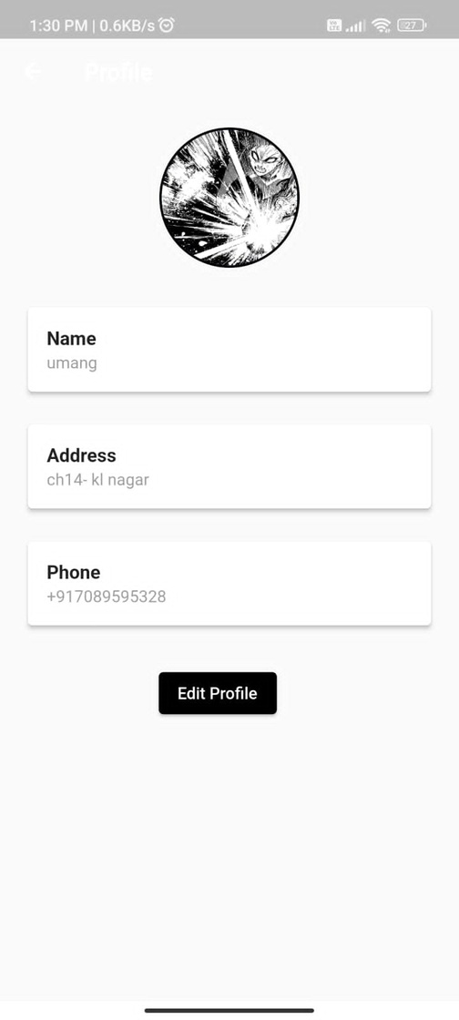
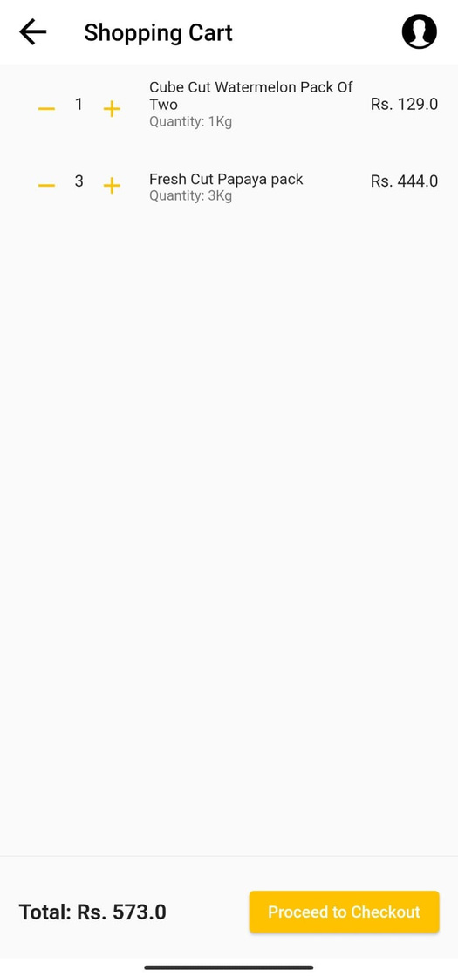
Implementation
Customer App
Customer Profile
Shopping cart

Slide 30
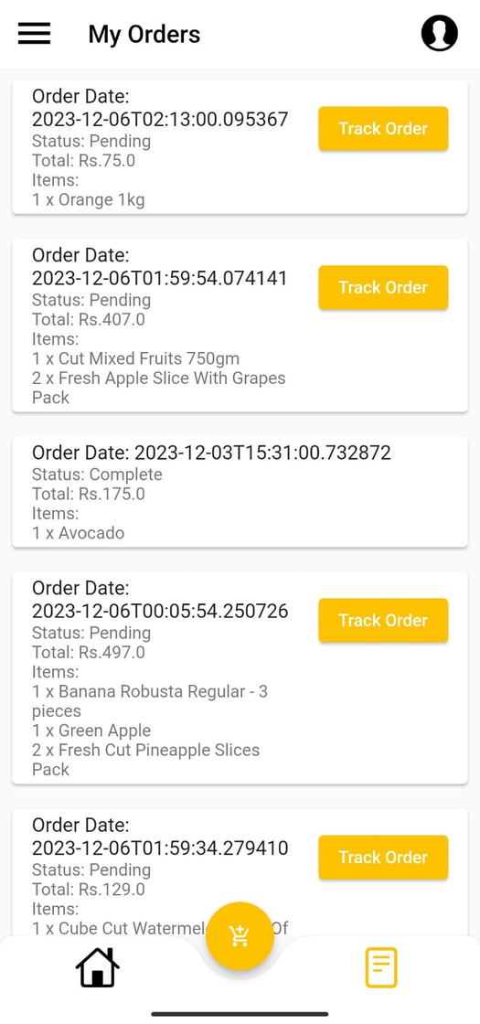
Implementation
Customer App
My Order Screen

Slide 31
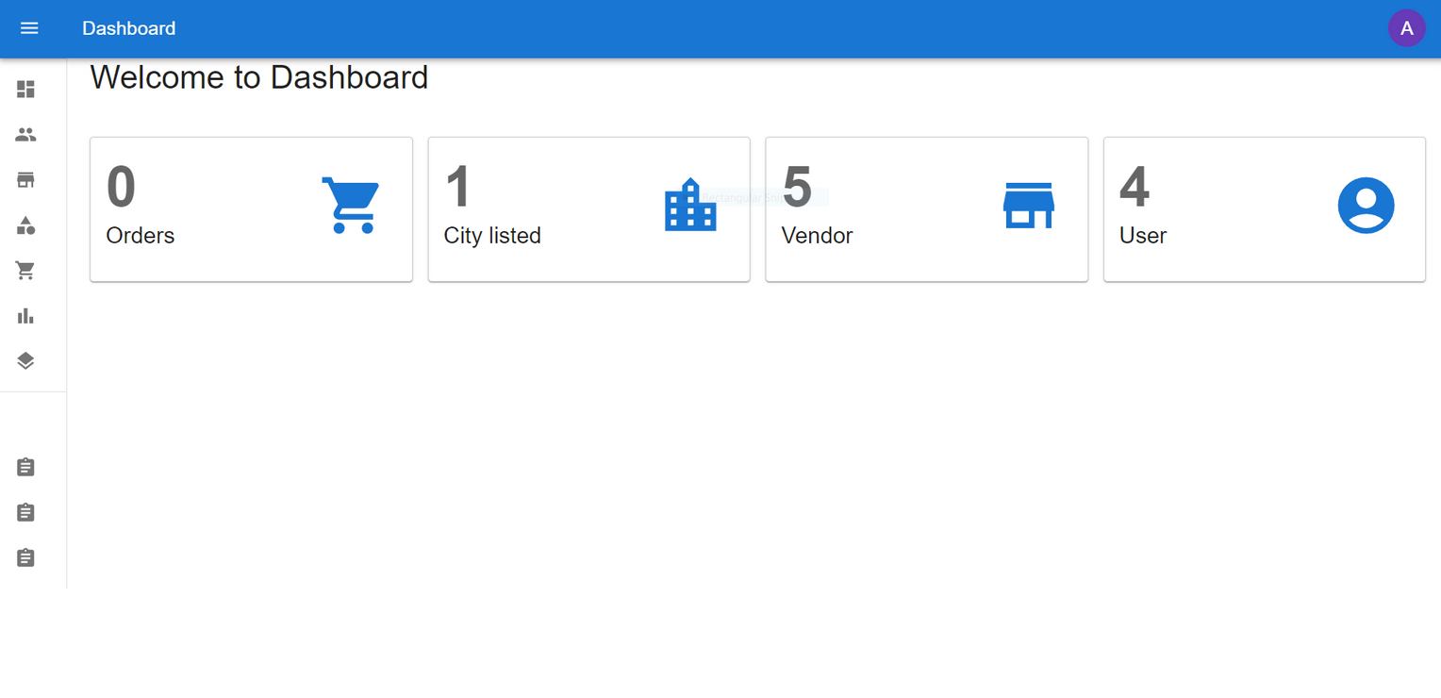
Implementation
Admin Panel
Dashboard

Slide 32
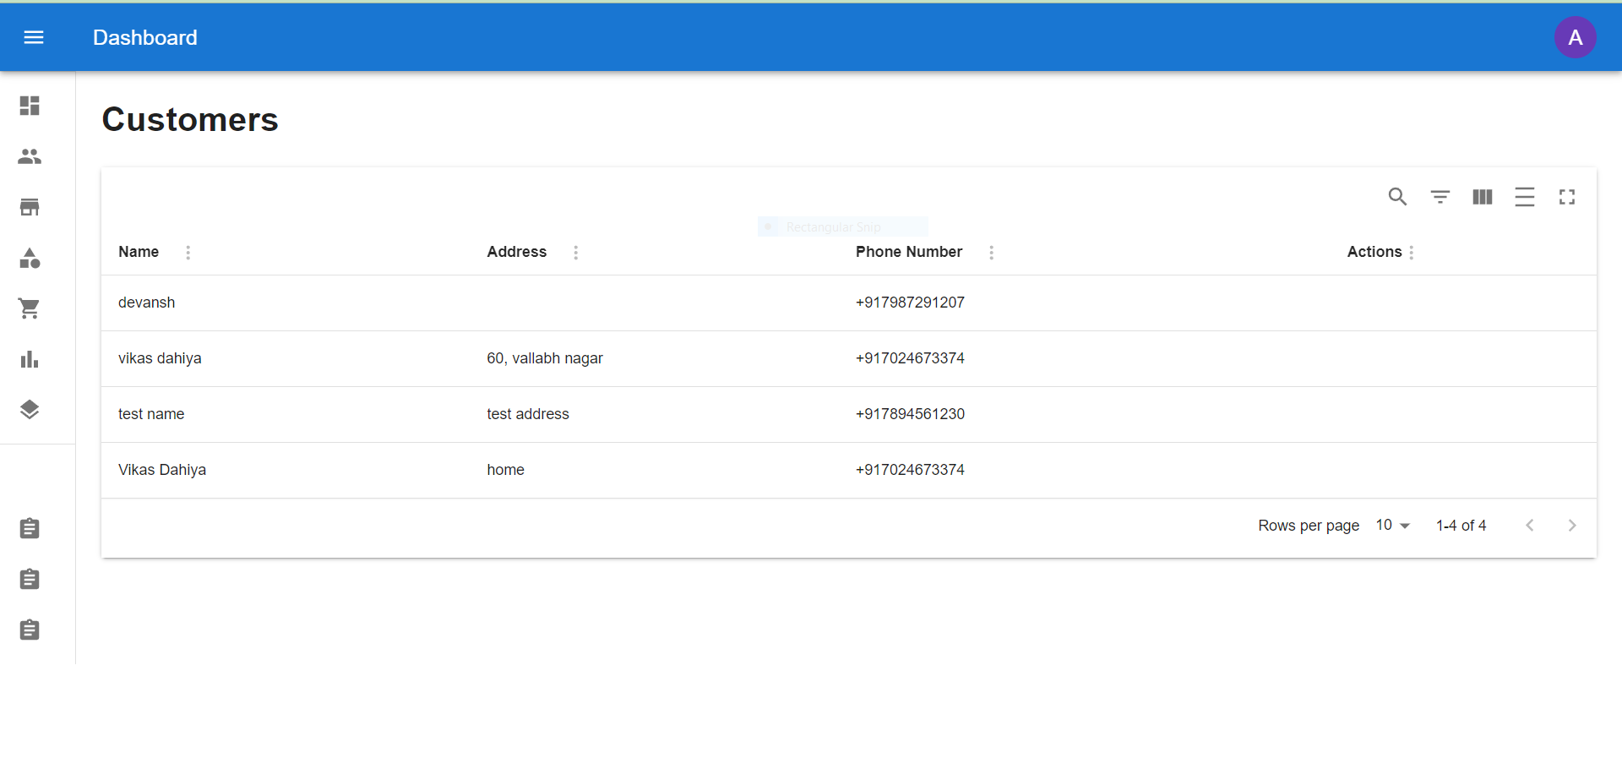
Implementation
Admin Panel

Slide 33
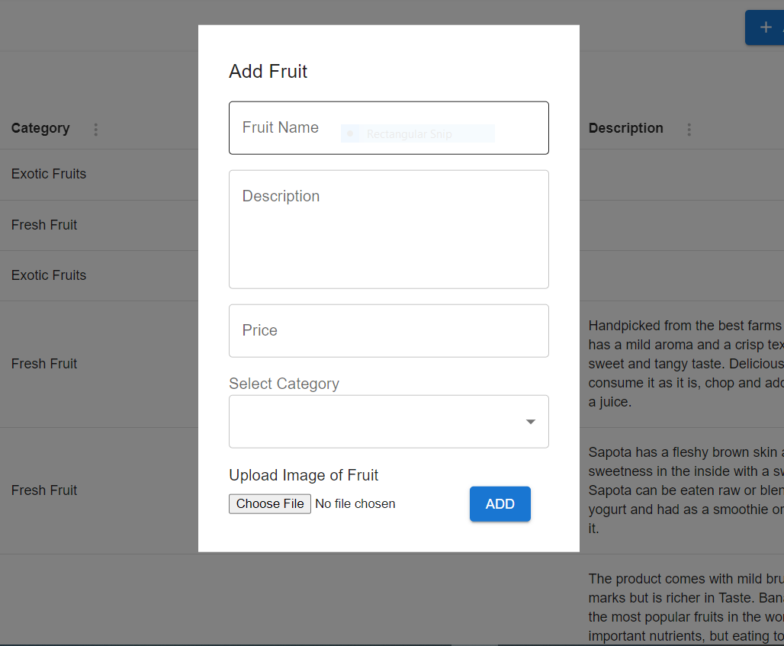
Implementation
Admin Panel

Slide 34
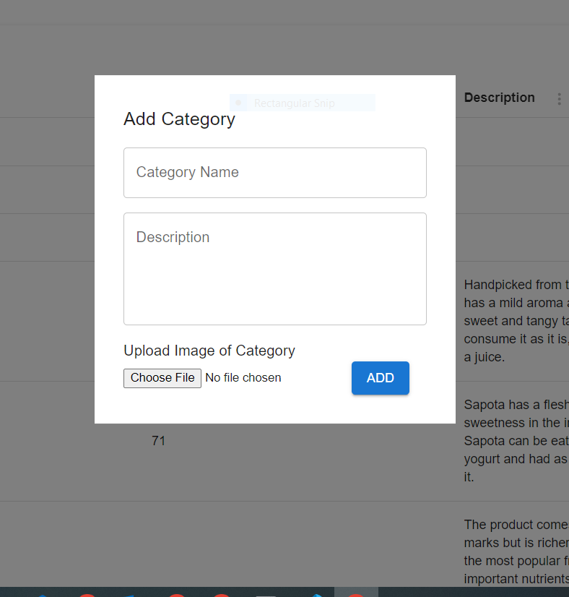
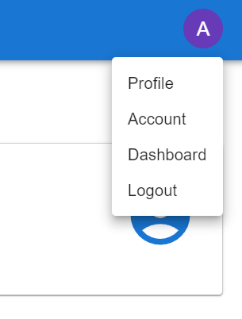
Implementation
Admin Panel

Slide 35
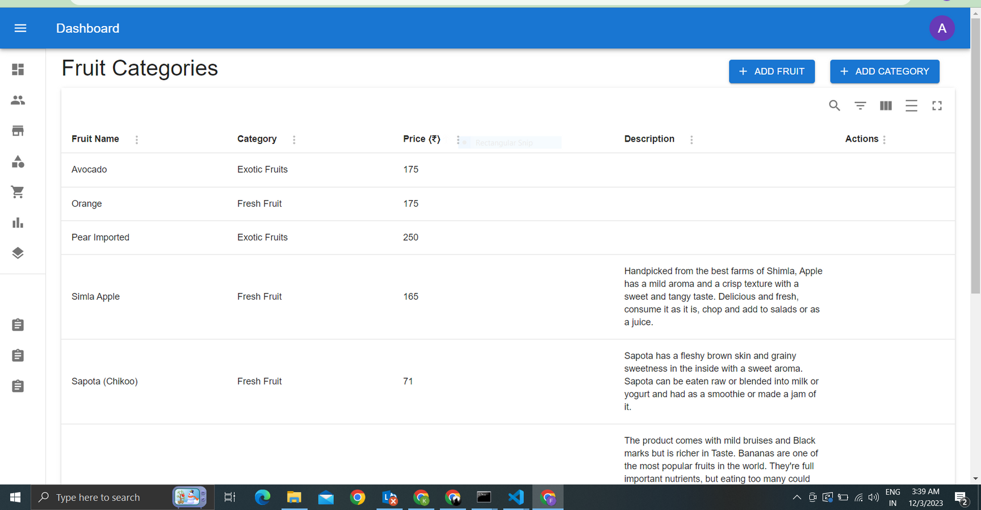
Implementation
Admin Panel

Slide 36
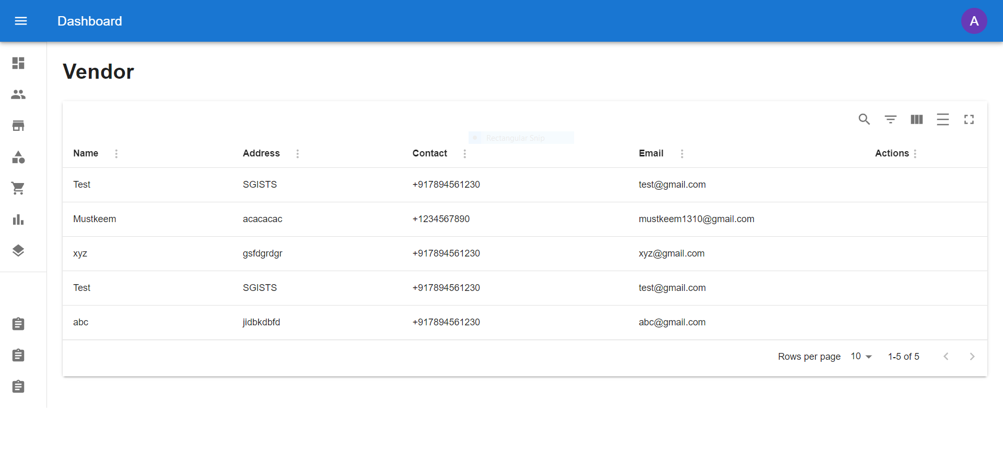
Implementation
Admin Panel

Slide 37
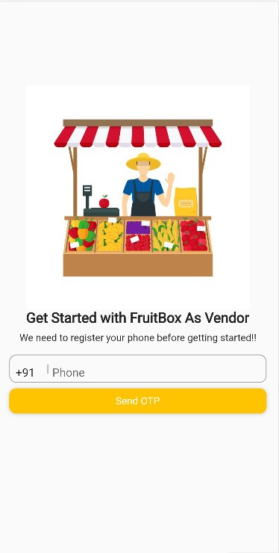
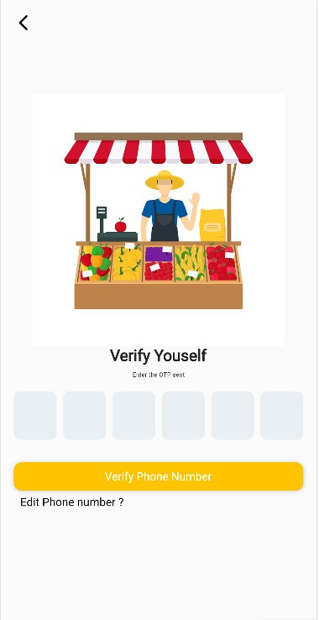
Implementation
Vendor App
Phone Number Login
OTP Verification

Slide 38
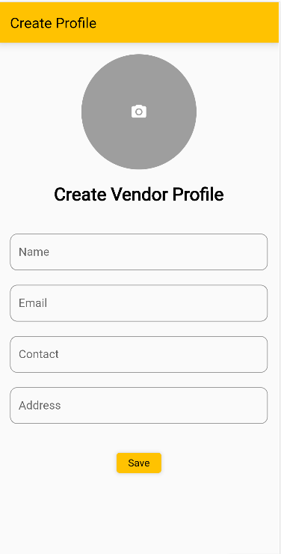
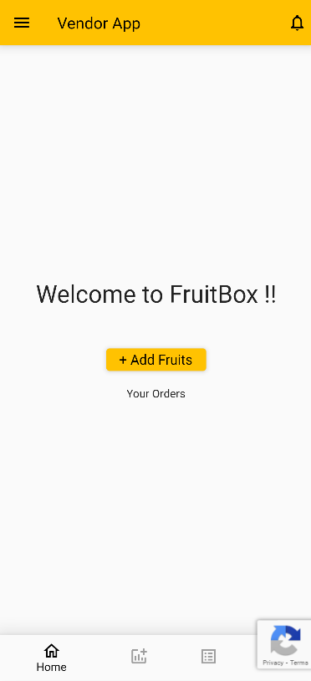
Implementation
Vendor App
Create Vendor Profile
Vendor Home Screen

Slide 39
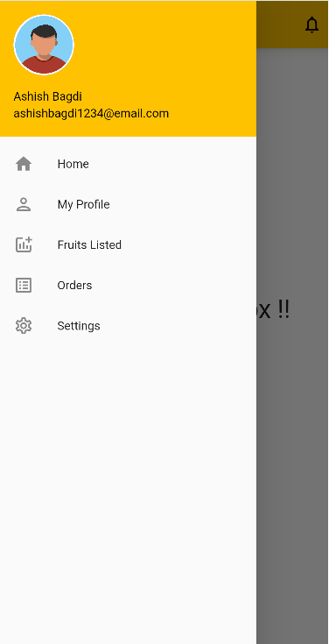
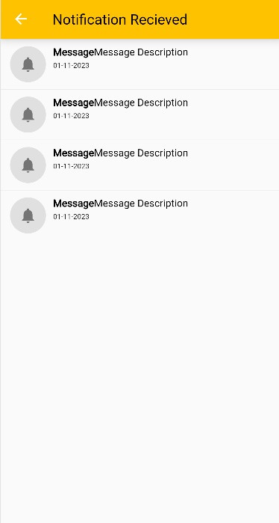
Implementation
Vendor App
Vendor Side Panel Screen
Notification Screen

Slide 40
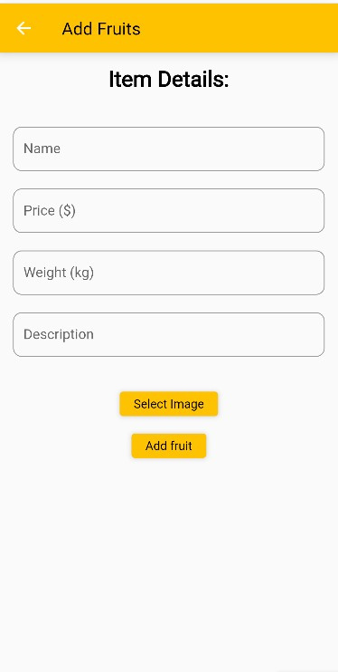
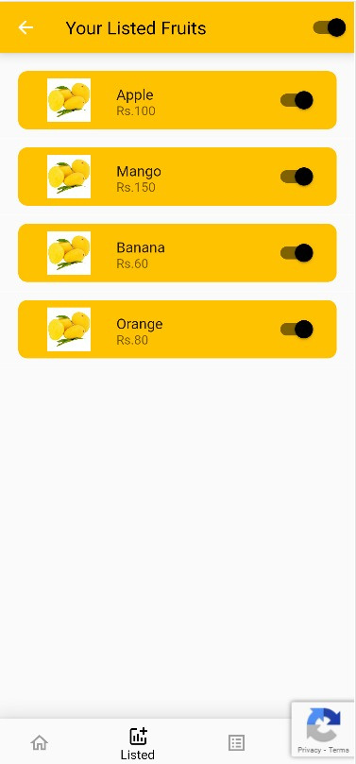
Implementation
Vendor App
List Fruits
Listed Fruits Screen

Slide 41
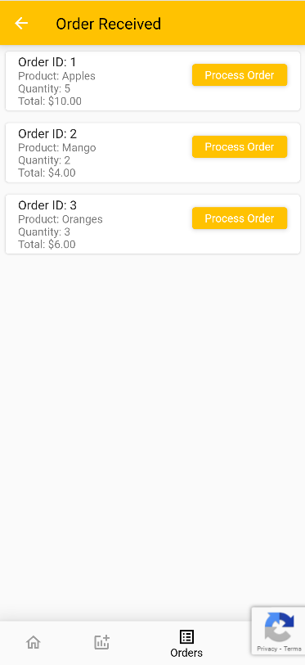
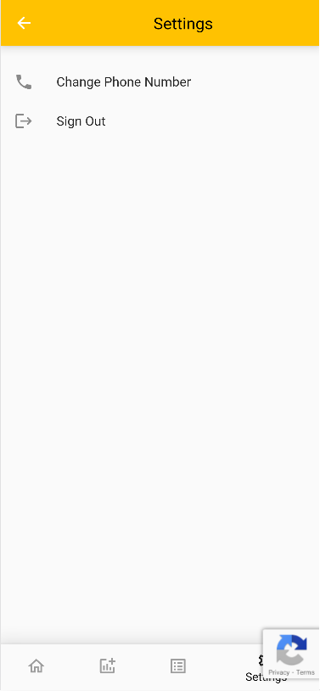
Implementation
Vendor App
Order Screen
Settings Screen

Slide 42
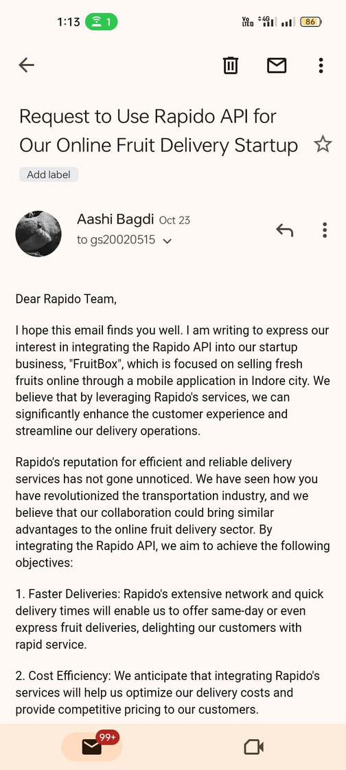
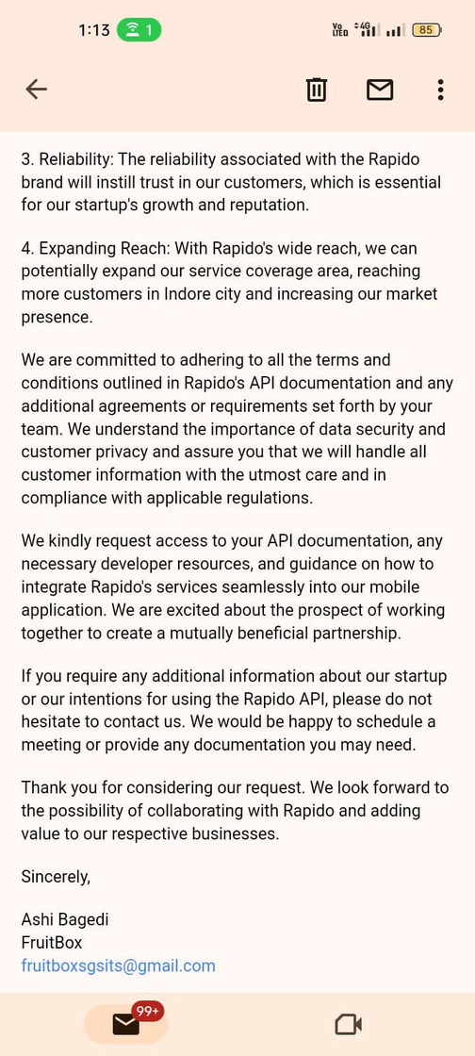
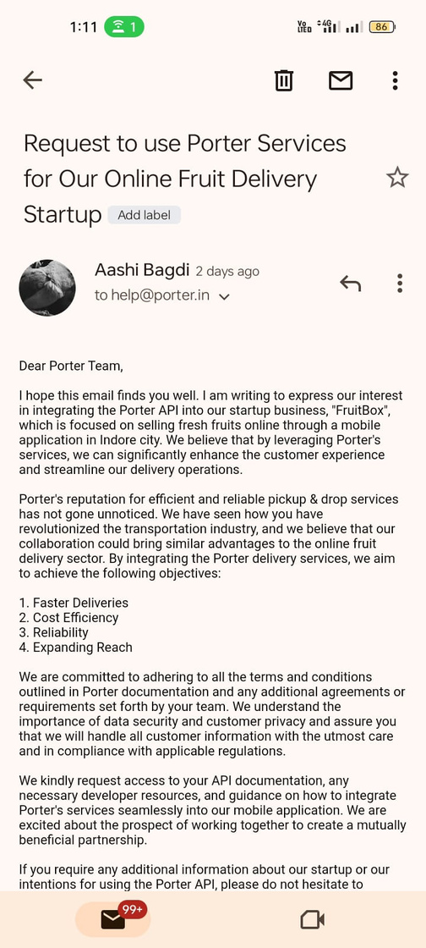
Send Request To Rapido & Porter Use API

Slide 43
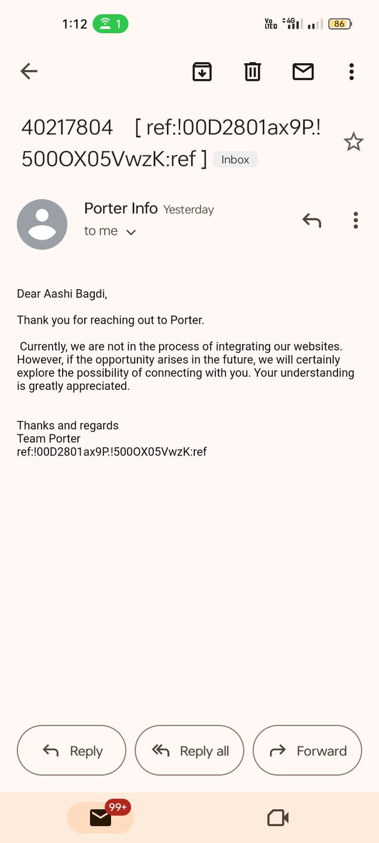
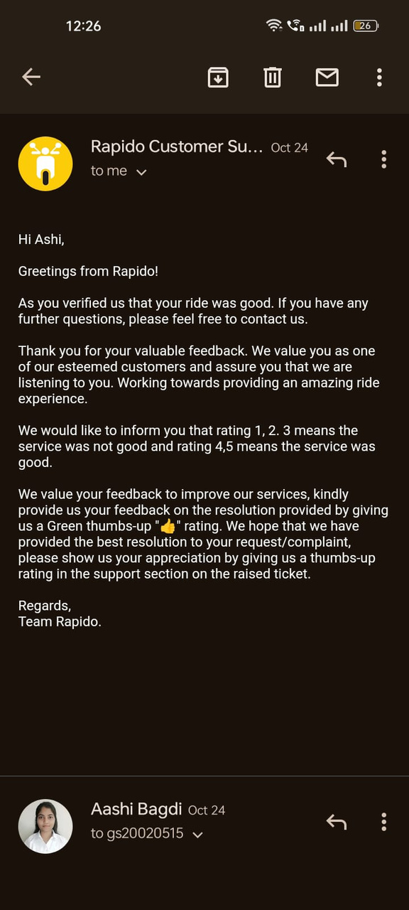
Response From Rapido & Porter
Porter said that currently they are not in the process of API integration.
Rapido said that they have bond with other companies so, they are not allowed to do so.

Slide 44
Solution To This Problem
1 .Delivery carried out by vendor personnel:
We can partner with reliable vendors to handle the delivery process at their end.
2. Develop an In-House Delivery System:
Alternatively, we can establish our own delivery system, integrating it into our applications.

Slide 45
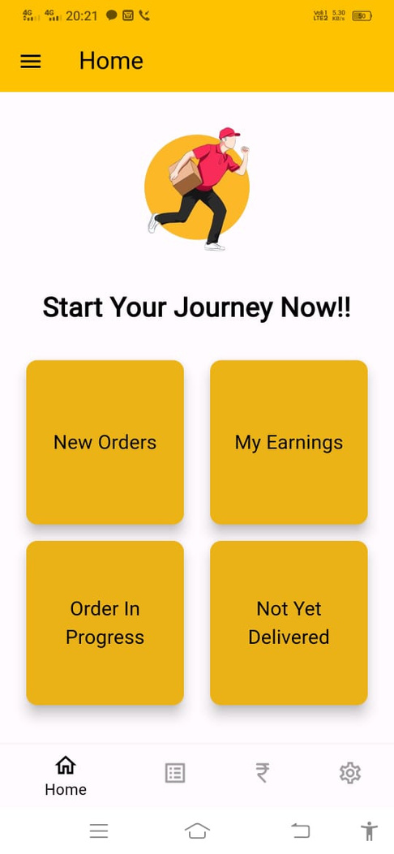
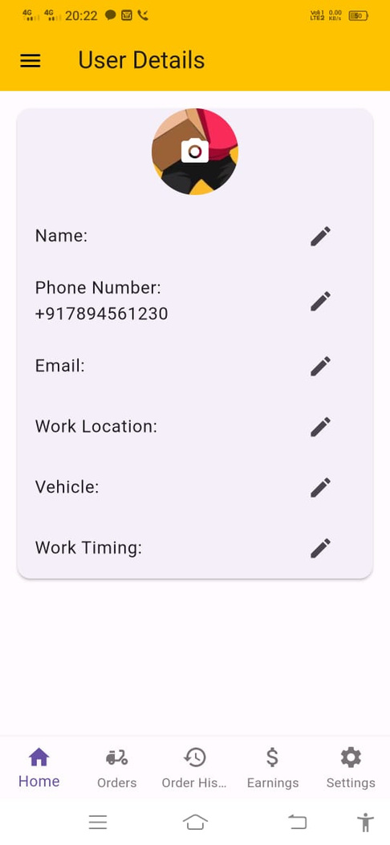
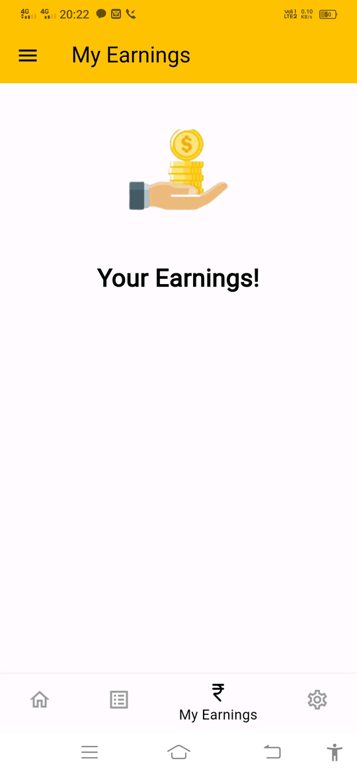
Delivery App

Slide 46
Testing Applications
Step | Action | Expected System | Pass/Fail
1 | Login with user phone number | Login requested will be rejected | Pass
2 | Enter valid phone number | User will be prompted to enter OTP | Pass
3 | Click on submit button | Validated & OTP send to user phone number | Pass
4 | Enter valid OTP & submit | Successful registration of user | Pass
Test Case Name: User Registration
System: Fruit ordering application (customer & vendor app)
Description: Test registration with user phone number on android application.
Precondition: System of the end user should be connected to the internet.
Post condition: User now able to login into fruitbox customer application.

Slide 47
Testing Applications
Test Case Name: User Registration
System: Fruit ordering application (customer & vendor app)
Description: Test registration with user phone number on android application.
Precondition: System of the end user should be connected to the internet.
Post condition: User now able to login into fruitbox customer application.
Step | Action | Expected System | Pass/Fail
1 | Select/Search desired fruits | Fruits successfully selected/searched | Pass
2 | Adjust the quantity of selected fruits. | Fruits successfully adjusted | Pass
3 | Click on add to cart | Fruits successfully added to the cart | Pass

Slide 48
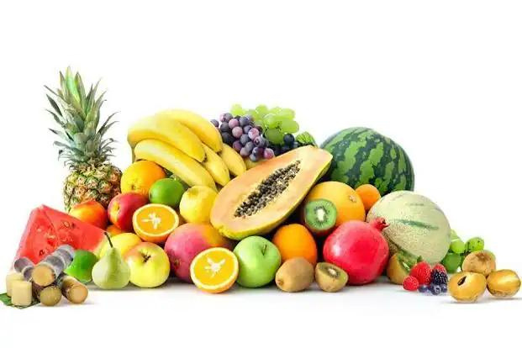
THANK YOU

